Slide 1
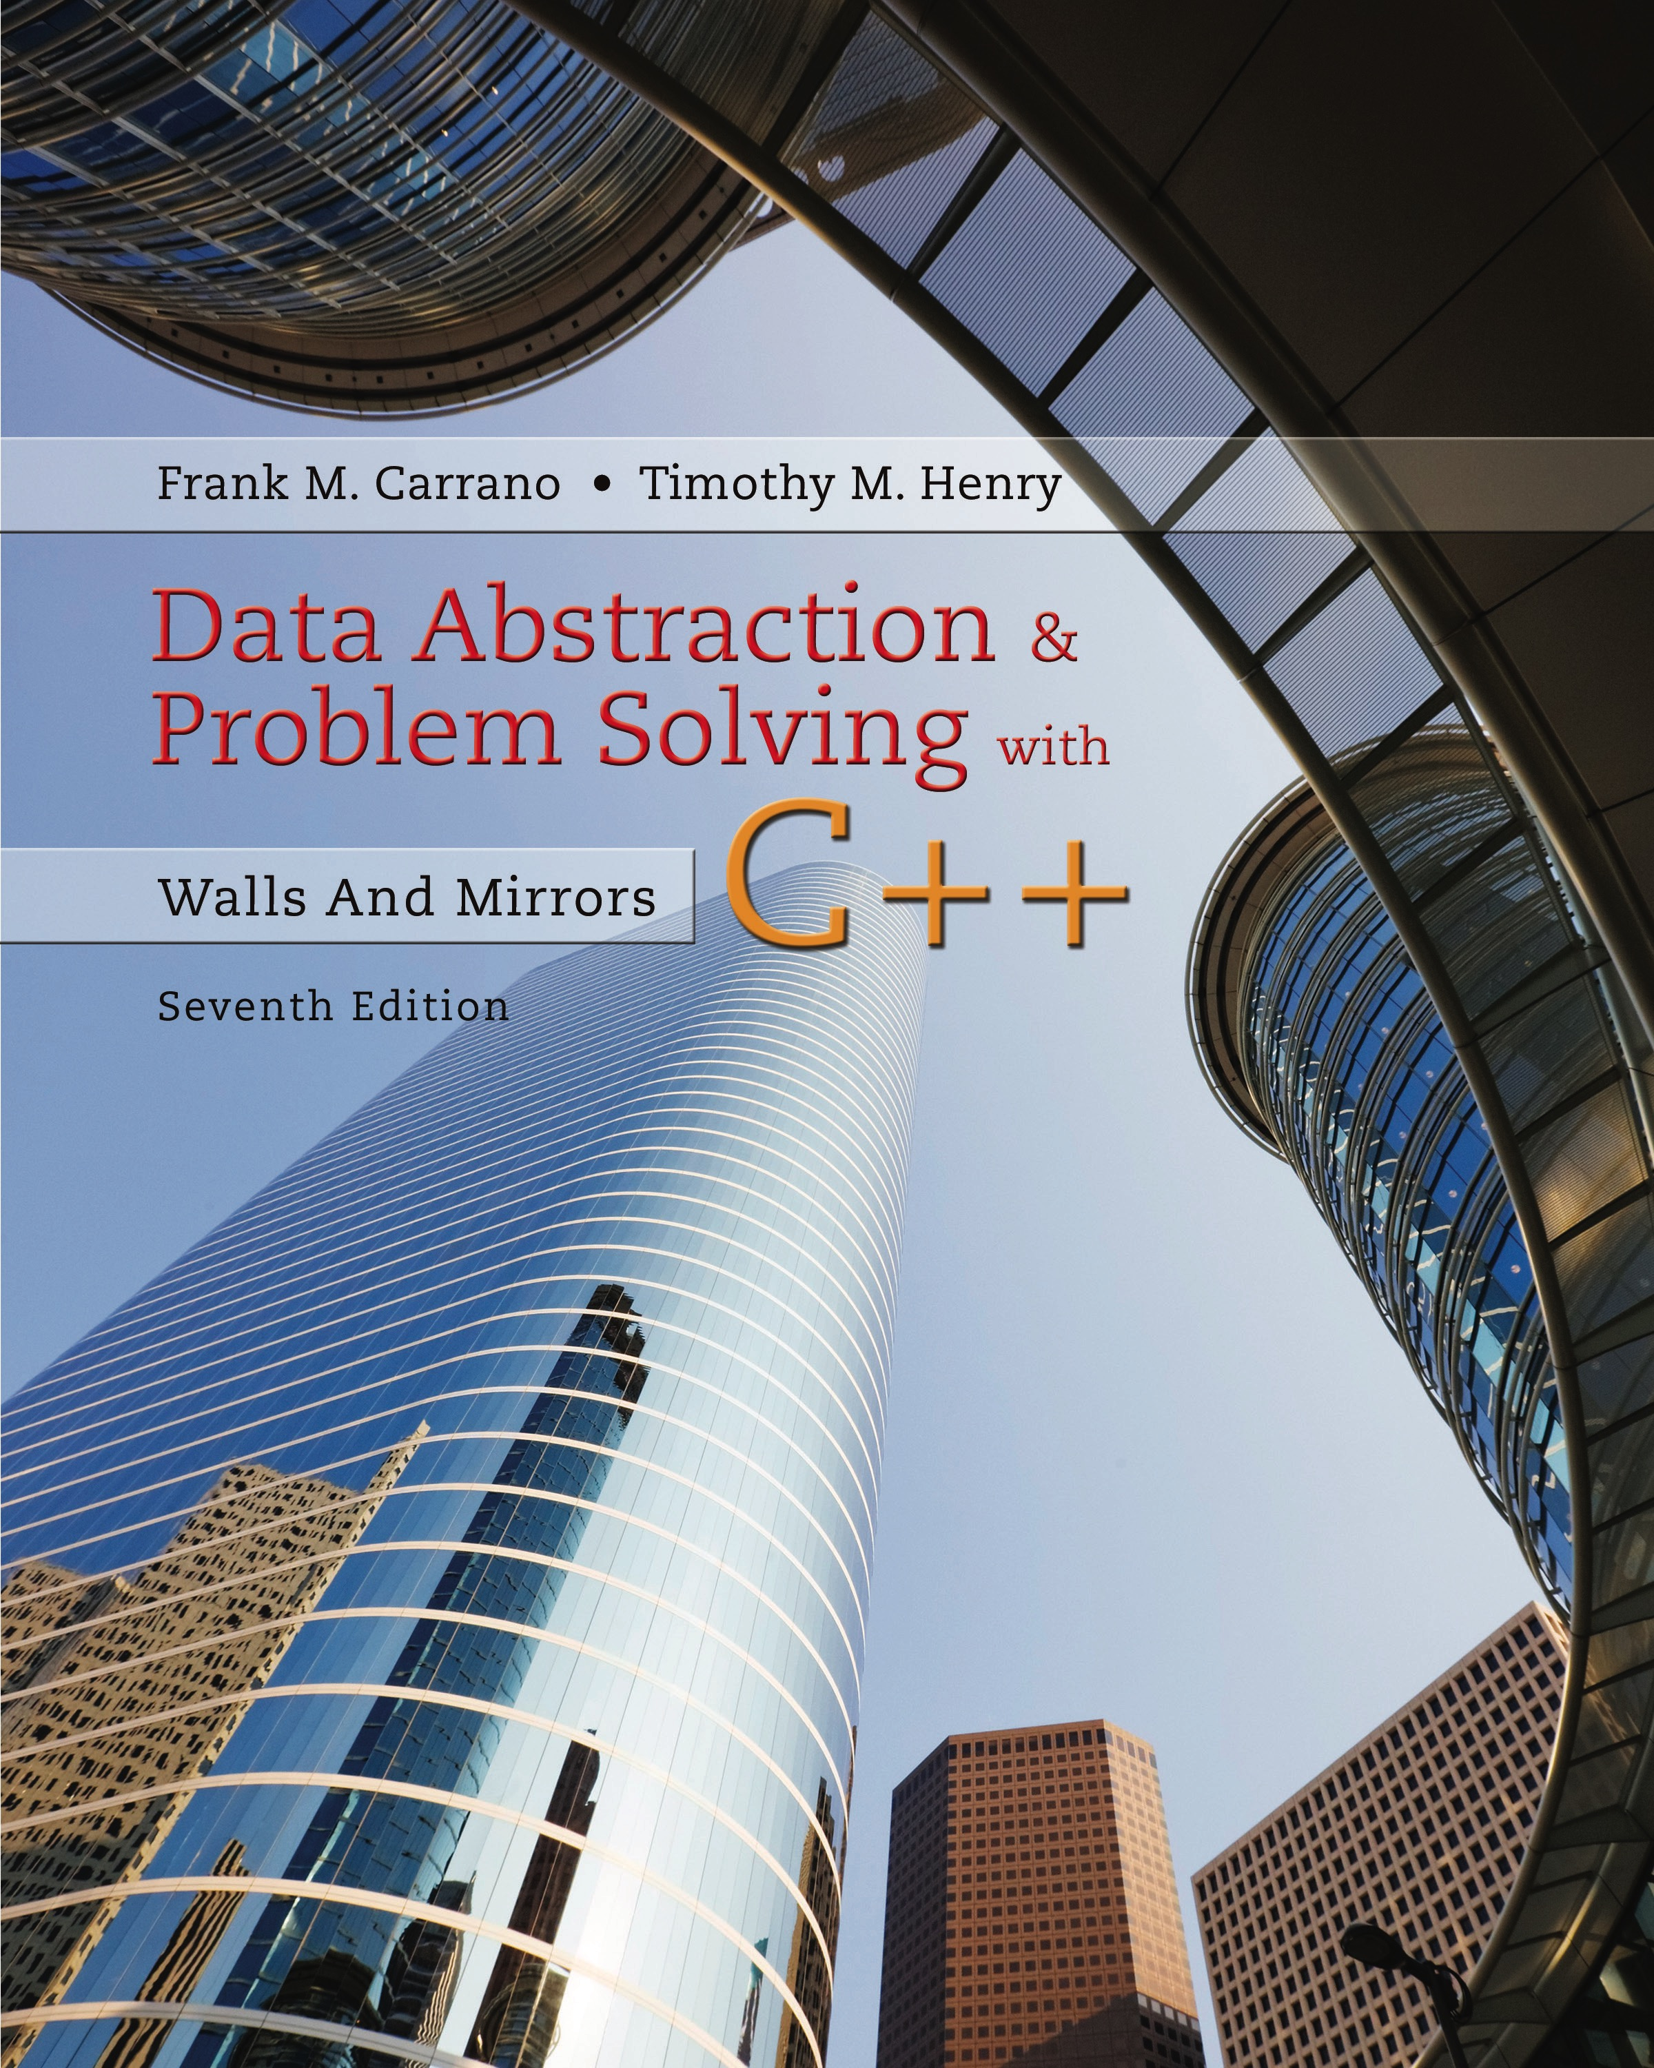
Data Abstraction & Problem Solving with C + +: Walls and Mirrors
Seventh Edition
C + + Interlude 2
Pointers, Polymorphism, and Memory Allocation
Copyright © 2017, 2013, 2007 Pearson Education, Inc. All Rights Reserved
Notes:
If this PowerPoint presentation contains mathematical equations, you may need to check that your computer has the following installed:
1) MathType Plugin
2) Math Player (free versions available)
3) NVDA Reader (free versions available)

Slide 2
Memory Allocation for Variables and Early Binding of Methods (1 of 3)
Declare variable x to have data type int
C + + compiler allocates memory cell to hold an integer
Use the identifier x to refer to this cell
A function’s locally declared variables
Placed into an activation record with parameters and bookkeeping data
Activation record placed on run-time stack
Activation record destroyed when function finished

Slide 3
Memory Allocation for Variables and Early Binding of Methods (2 of 3)
Storage for data members of an object
Also placed into an activation record.
Data fields placed on the run-time stack just as primitive data types are.
This is early binding , made during compilation
Cannot be altered during execution

Slide 4
Memory Allocation for Variables and Early Binding of Methods (3 of 3)
Automatic memory management and early binding sometimes insufficient
Need to take advantage of polymorphism.
Must access an object outside of the function or method that creates it.

Slide 5
Problem to Solve (1 of 5)
Need to write a function – takes two arguments:
An object of any of the three types of boxes (from Interlude 1)
An item of type string
Function should place item in box by invoking box’s setItem method

Slide 6
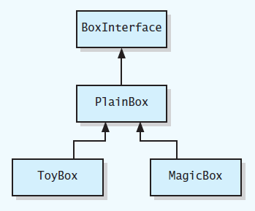
Problem to Solve (2 of 5)
Figure C2-1 U M L class diagram for a family of classes

Slide 7
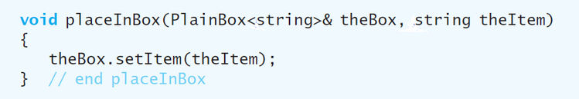
Problem to Solve (3 of 5)
You may think this function would suffice

Slide 8
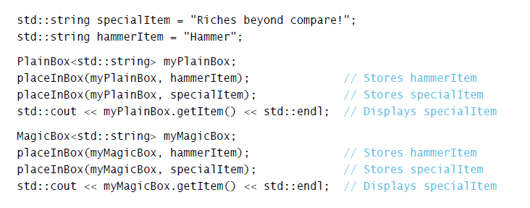
Problem to Solve (4 of 5)
Used in this context
Code compiles, but does not perform as you would expect due to

Slide 9
Problem to Solve (5 of 5)
Version of setItem called is determined when the program is compiled.
Need a way to communicate to compiler
Code to execute should not be determined until program is running.
Called late binding

Slide 10
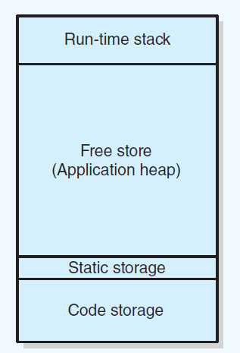
Pointers and Program’s Free Store (1 of 4)
Figure C2-2 Sample program memory layout

Slide 11
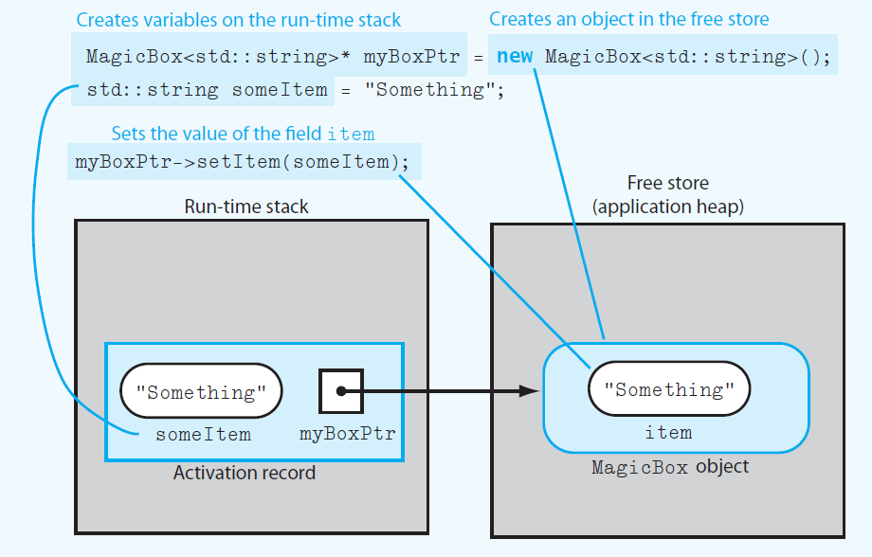
Pointers and Program’s Free Store (2 of 4)
Figure C2-3 Run-time stack and free store after myboxPtr points to a MagicBox object and its data member item is set

Slide 12
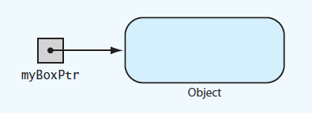
Pointers and Program’s Free Store (3 of 4)
Figure C2-4 myBoxPtr and the object to which it points

Slide 13
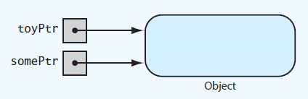
Pointers and Program’s Free Store (4 of 4)
Figure C2-5 Two pointer variables that point to the same object

Slide 14
Deallocating Memory
When memory to which pointer variable points is no longer needed
Deallocate it by using delete operator.
Then set pointer variable to nullptr
Otherwise dangling pointer exists
It would still contain address of object that was deallocated.
Can be source of serious errors.

Slide 15
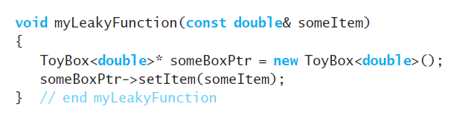
Avoiding Memory Leaks (1 of 4)
Memory leaks occur when
An object has been created in the free store, but
Program no longer has a way to access
Listing C2-1 Poorly written function that allocates memory in the free store

Slide 16
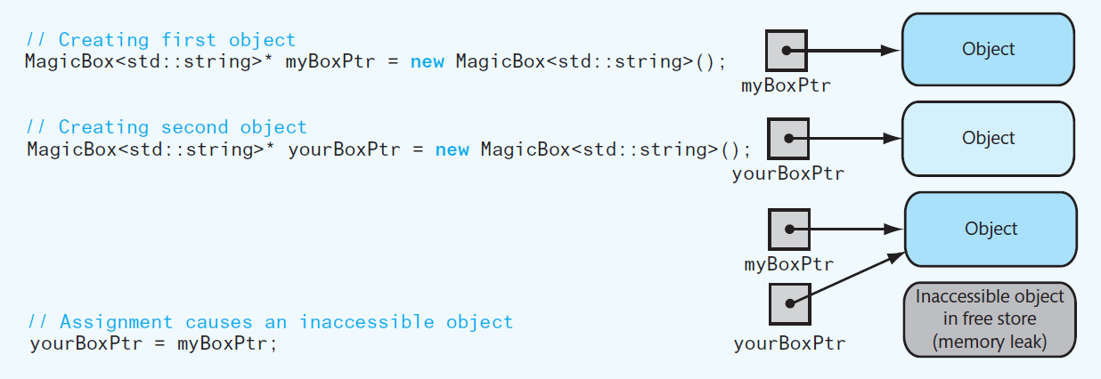
Avoiding Memory Leaks (2 of 4)
Figure C2-6 An assignment that causes an inaccessibl object.
To prevent memory leak, do not use a function to return a pointer to a newly created object

Slide 17
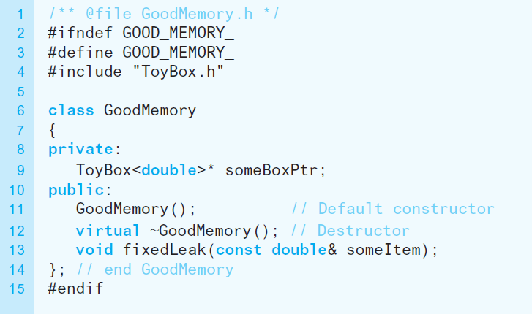
Avoiding Memory Leaks (3 of 4)
Listing C2-2 Header file for the class GoodMemory

Slide 18
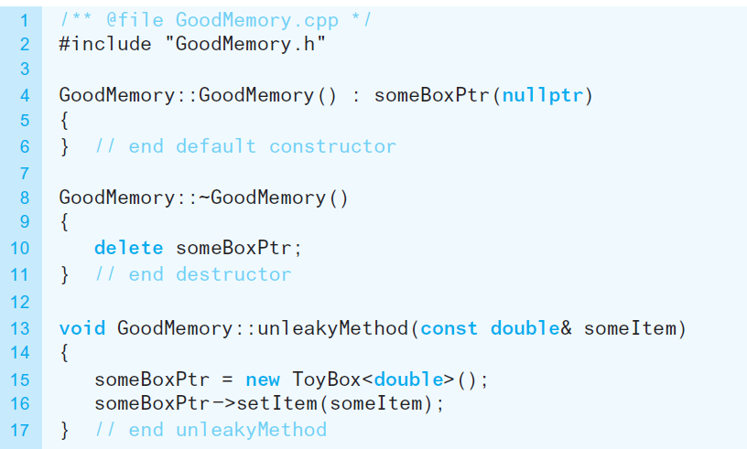
Avoiding Memory Leaks (4 of 4)
Listing C2-3 Implementation file for the class GoodMemory

Slide 19
Avoiding Dangling Pointers (1 of 3)
Situations that can cause dangling pointer
if you do not set a pointer variable to nullptr after using delete
If you declare a pointer variable but do not assign it a value

Slide 20
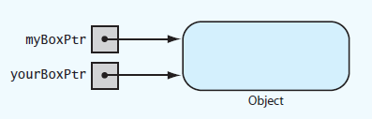
Avoiding Dangling Pointers (2 of 3)
Figure C2-7 Two pointers referencing (pointing to) the same object

Slide 21
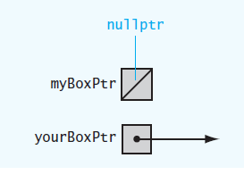
Avoiding Dangling Pointers (3 of 3)
Figure C2-8 Example of a dangling pointer

Slide 22
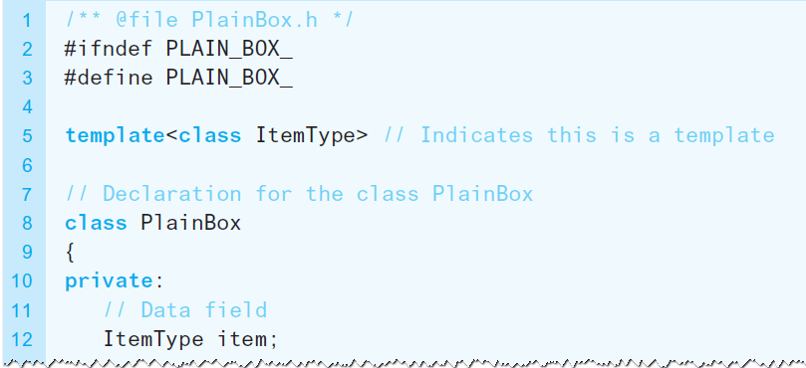
Virtual Methods and Polymorphism (1 of 4)
Allow compiler to perform the late binding necessary for polymorphism
Declare methods in base class as virtual.
Listing C2-4 Revised header file for the class PlainBox

Slide 23
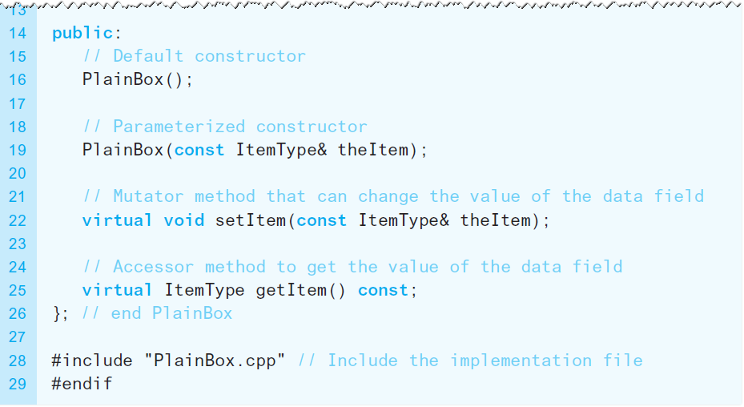
Virtual Methods and Polymorphism (2 of 4)
Listing C2-4 Revised header file for the class PlainBox

Slide 24
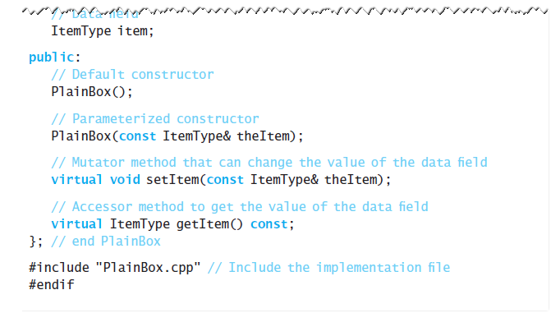
Virtual Methods and Polymorphism (3 of 4)
Listing C2-4 Revised header file for the class PlainBox

Slide 25
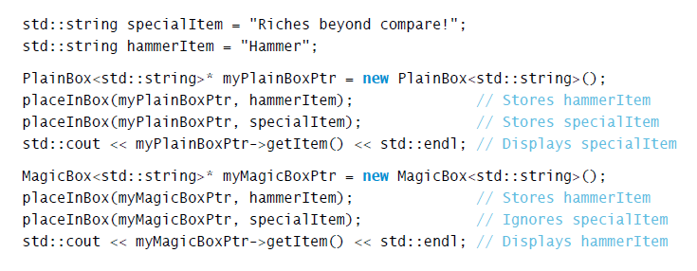
Virtual Methods and Polymorphism (4 of 4)
To fully implement late binding, create variables in free store and use pointers to reference them

Slide 26

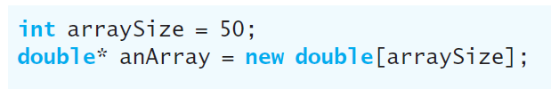
Dynamic Allocation of Arrays (1 of 2)
An ordinary C + + array is statically allocated
Can use new operator to allocate an array dynamically

Slide 27

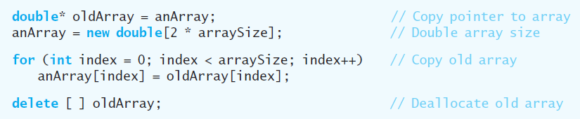
Dynamic Allocation of Arrays (2 of 2)
delete returns a dynamically allocated array to system for reuse
Increase size of dynamically allocated array

Slide 28
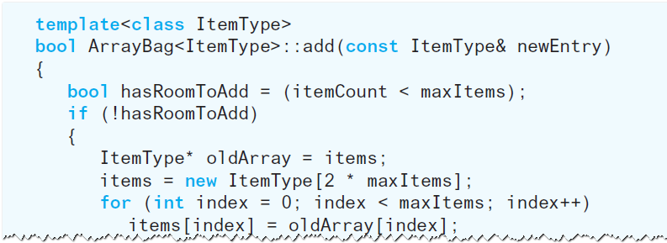
A Resizable Array-Based Bag (1 of 2)
Use a resizable array to implement A D T bag so that bag never becomes full

Slide 29
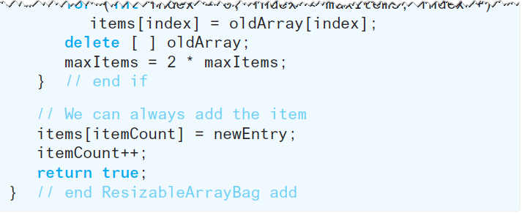
A Resizable Array-Based Bag (2 of 2)
Use a resizable array to implement A D T bag so that bag never becomes full

Slide 30

Copyright

